Slide 1
Intelligent/Macro/Micro/Sustainable/DG Smart(er) Grids: Opportunities and Challenges
P. F. Ribeiro, PhD
Calvin College, Grand Rapids, Michigan, USA
Technical University of Eindhoven, Eindhoven, The Netherlands

Slide 2
Acknowledgments
This set of viewgraphs use (with permission) materials from the following sources and which we acknowledge with gratitude:
R. C Dugan, M. F McGranaghan, S. Santoso, W. Beaty, Electrical Power Systems Quality, McGraw Hill 2002.
Material from M. Bollen, A. Emanuel, J. Arrilagga, G. Chang, N. Mohan, S. Cobben, Leonardo Energy, EPRI, Sandia National Laboratory.
Personal Notes and unpublished material from P.F. Ribeiro
Other references - - - include IEEE, ENERNEX, DOE, IEC and CIGRE Working Groups Discussions and Documents
Some viewgraphs have been modified to emphasize certain aspects.

Slide 3
Outline
A Bit of Philosophy
Introduction
What is a Smart(er) Grid?
Impact of MG-DG-DER-RES (Smart Grids)
Implications on Signal Measurement
Challenges and Opportunities
Research and Development Directions
Politics and Economics
Personal Notes

Slide 4
Functions of Philosophy
Analytical
Critical
Directive

Slide 5
Technology: Integrating a Complex World
Engineering Design Needs to Integrate Them All
Aspects
Parts
Systems

Slide 6
Engineering Design and Philosophical Questions

Slide 7
Engineering Design Process, Factors and Fundamental Aspects

Slide 8
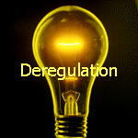
Introduction The Context
One of the most used terms in the utility industry in the last decades is “DEREGULATION” and which has caused deep changes in way power systems are designed and operated.
The centralized and verticalized grid model based on electromechanical components, will be substituted by distributed and unbundled model with digitalized components. Generation, control and measurement will suffer changes and impacts with this new model. Power systems and power quality paradigms will be broken.
Independently of political actions that establishes commercial objectives and issues to the utilities and customers, the new model is being constructed and implemented with the objective to achive higher reliability, quality, lower costs, etc.
This is the context in which MacG-MicG-DG-DER-RES and SMART GRIDS are being developed.

Slide 9
Introduction
The Big Picture – Smart Living
Intelligent / Sustainable
Cities
Buildings, Houses, Transportation,
Electric Grid
Distributed (Renewable) Energy Sources
Regionally Optimized Portfolio /Mix of Renewable Energy
Integration with Macro and Micro Grids
Normative Practices
Economics, Market, Business
Political Will
For Caring and Just Communities
Smart Living
Attractively / Aesthetically / Ecologically Friend / Stable
Environment

Slide 10
Introduction Great Expectations
"a new smart grid ... will save us money, protect our power sources from blackout or attack, and deliver clean, alternative forms of energy to every corner of our nation."
President Obama in an address at the George Mason University, Fairfax, VA on Jan 8, 2009¹
2009 - banner year for Smart Grid; Year of the Smart Grid for VCs Smart Grid News, www.smartgridnews.com
During the next 4 years, KEMA anticipates $16 billion in Smart Grid incentives for driving Smart Grid projects worth $64 billion. The will result in direct creation of 280,000 new positions across various categories, of which more than 150,000 will be created by the end of 2009²
¹ Environment News Service. “Obama vows dramatic action towards a greener economy.” [Online] {Available} http://www.ens-newswire.com/ens/jan2009/2009-01-08-01.asp (Sep 2009)
² Kema Inc. “The U.S. Smart Grid Revolution KEMA’s Perspectives for Job Creation,” Report prepared for Gridwise Alliance, Dec 08 .
Notes:
[1] http://www.ens-newswire.com/ens/jan2009/2009-01-08-01.asp

Slide 11
Introduction The Path Toward the Smart Grid: Thus Far
The Electricity Advisory committee (EAC) recommended to DoE to create a Smart Grid Program Office in Dec 2008 ^{[3]}
US Congress includes ~ $4.5B for Smart Grid deployment ^{[4]}
Several smart grid projects underway across the US - microgrids, AMI, smart workforce developments, standard developments, renewable energy deployments, etc.
NIST is the national coordinator for Smart Grid Interoperability
Released framework and roadmap for SG interoperability Stds. on Sep 24, 2009
IEEE PES created a Transactions on Smart Grid
³ Electricity Advisory Committee, United States Department of Energy, “Smart Grid: Enabler of the New Energy Economy,” [Online] {Available}: http://www.oe.energy.gov/DocumentsandMedia/final-smart-grid-report.pdf (Jan. 2009)
⁴ 111th Congress of USA, “American recovery and reinvestment act of 2009,” [Online] {Available} http://frwebgate.access.gpo.gov/cgi-bin/getdoc.cgi?dbname=111_cong_bills&docid=f:h1enr.pdf (Feb 2009)

Slide 12
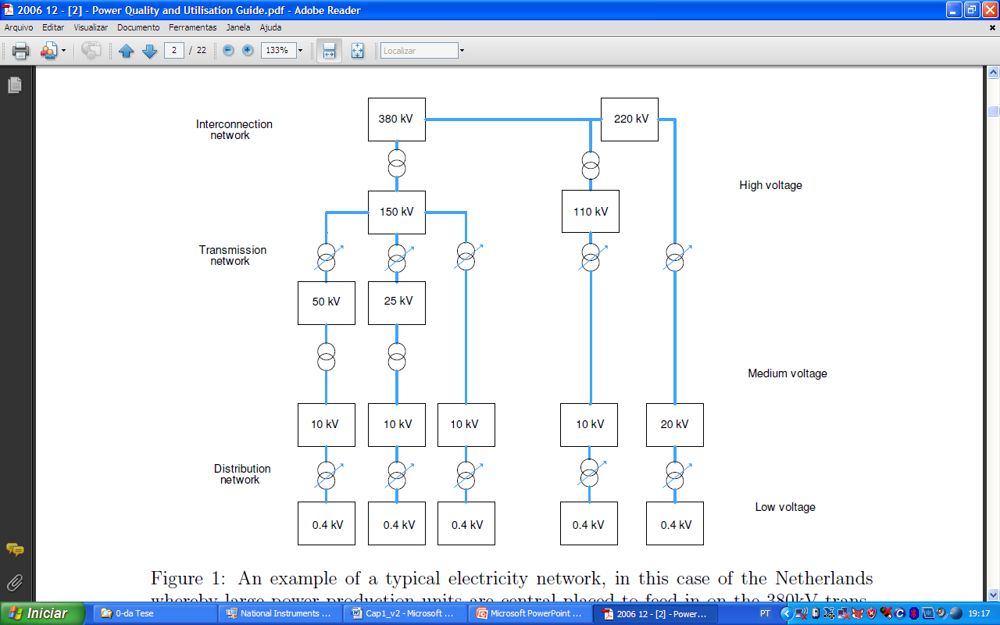
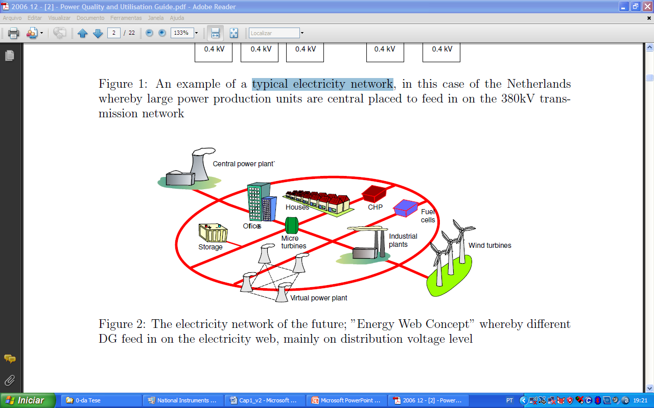
Introduction First, something about electricity network of the future
Electricity network of the future

Slide 13
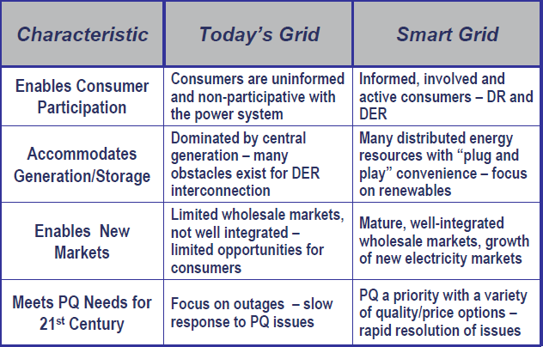
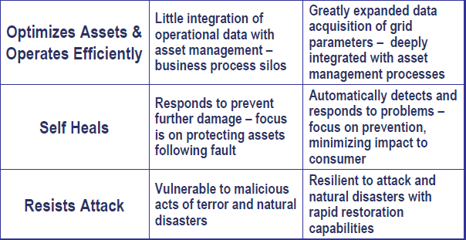


“Understanding the Smart Grid”, Joe Miller- Modern Grid Strategy team , May 19 2008

Slide 14
What is a Smart Grid, Really?
Nobody Really Knows!

Slide 15
What is a Smart Grid, Really? Merging Two Smart Infrastructures
Electrical (Smart) Infrastructure
Controls and Communications (Smart) Infrastructure

Slide 16
What is a Smart Grid, Really? Smart Grids Definitions
National Electrical Manufacturers Associations
The basic concept of Smart Grid is to add monitoring, analysis, control and communication capabilities to the national electric grid in order to improve reliability, maximize throughput, increase energy efficiency, provide consumer participation and allow diverse generation and storage options.
IEC
The Smart Grid is the concept of modernizing the electric grid. The Smart Grid comprises everything related to the electric system in between any point of Generation and any point of Consumption. It also includes the coupling effects with other forms of energy (thermal storage, etc…)
Smart Grids is basically the concept of making the power grid “SMARTER”

Slide 17
European Definition
Although there is no standard global definition, the European Technology Platform SmartGrids defines smart grids as electricity networks that can intelligently integrate the behavior and actions of all users connected to it - generators, consumers and those that do both – in order to efficiently deliver sustainable, economic and secure electricity supplies.

Slide 18
European Definition
A smart grid employs innovative products and services together with intelligent monitoring, control, communication, and self-healing technologies in order to:
Better facilitate the connection and operation of generators of all sizes and technologies;
Allow consumers to play a part in optimizing the operation of the system;
Provide consumers with greater information and options for choice of supply;
Significantly reduce the environmental impact of the whole electricity supply system;
Maintain or even improve the existing high levels of system reliability, quality and security of supply;
Maintain and improve the existing services efficiently;
Foster market integration towards European integrated market.

Slide 19
USA Perspective
The smart grid uses technological advancements to achieve its principal goals, which are summarized below.
Enables active consumer participation:
Accommodates all generation and storage options:
Enables new products, services, and markets:
Provides power quality for the digital economy:
Optimizes asset utilization and operates efficiently:
Anticipates and responds to system disturbances:
Operates resiliently against attack and natural disaster:

Slide 20
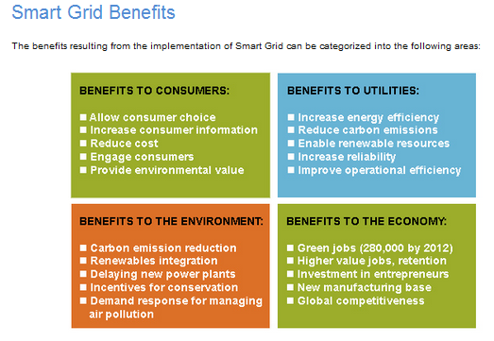

Slide 21
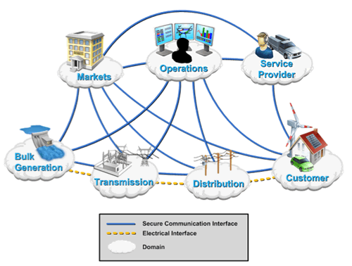
Smart Grid: Overalll View
Parts and Systems

Slide 22
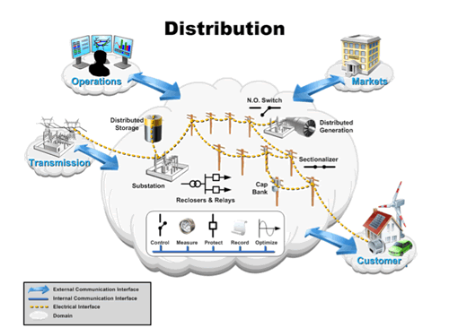
Smart Grid: Overalll View
Parts and Systems

Slide 23
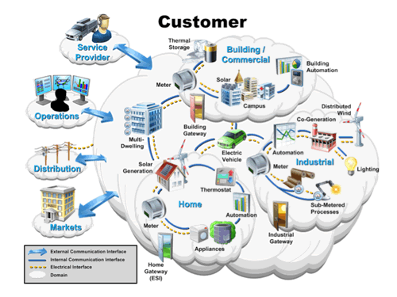
Smart Grid: Overalll View
Parts and Systems

Slide 24
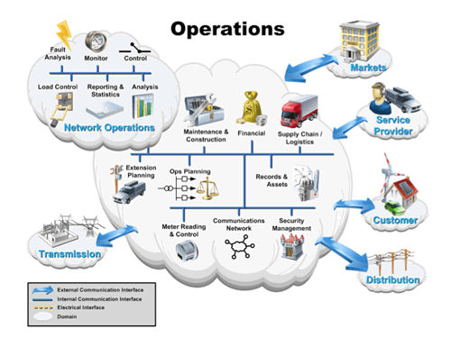
Smart Grid: Overalll View
Parts and Systems

Slide 25
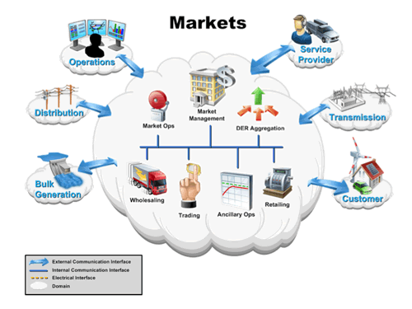
Smart Grid: Overalll View
Parts and Systems

Slide 26
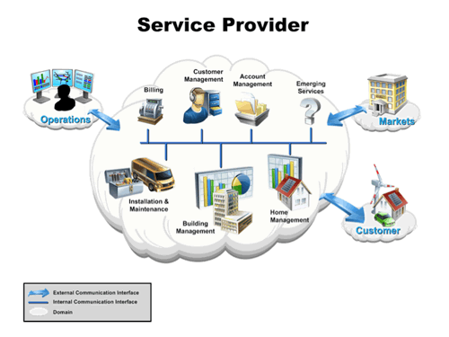
Smart Grid: Overalll View
Parts and Systems

Slide 27
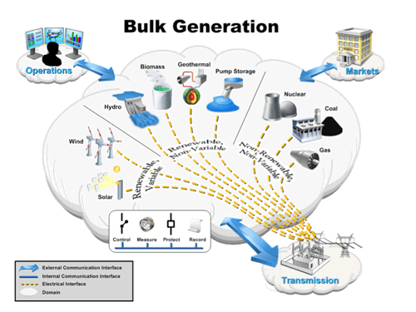
Smart Grid: Overalll View
Parts and Systems

Slide 28
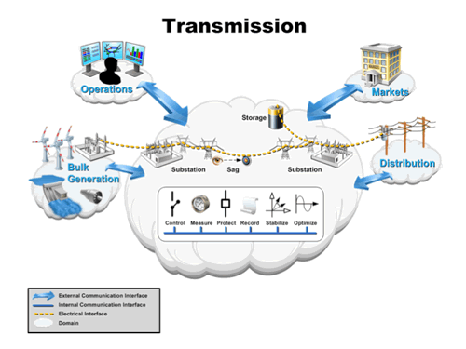
Smart Grid: Overalll View
Parts and Systems

Slide 29
What is a Smart Grid, Really? Smart Grid Applications
Real-time Simulation and Contingency Analysis
Distributed Generation and Alternate Energy Sources
Self-Healing Wide-Area Protection and Islanding
Asset Management and On-Line Equipment Monitoring
Demand Response and Dynamic Pricing
Participation in Energy Markets
Shared Information – Continuously Optimizing
Intelligent Responses!

Slide 30
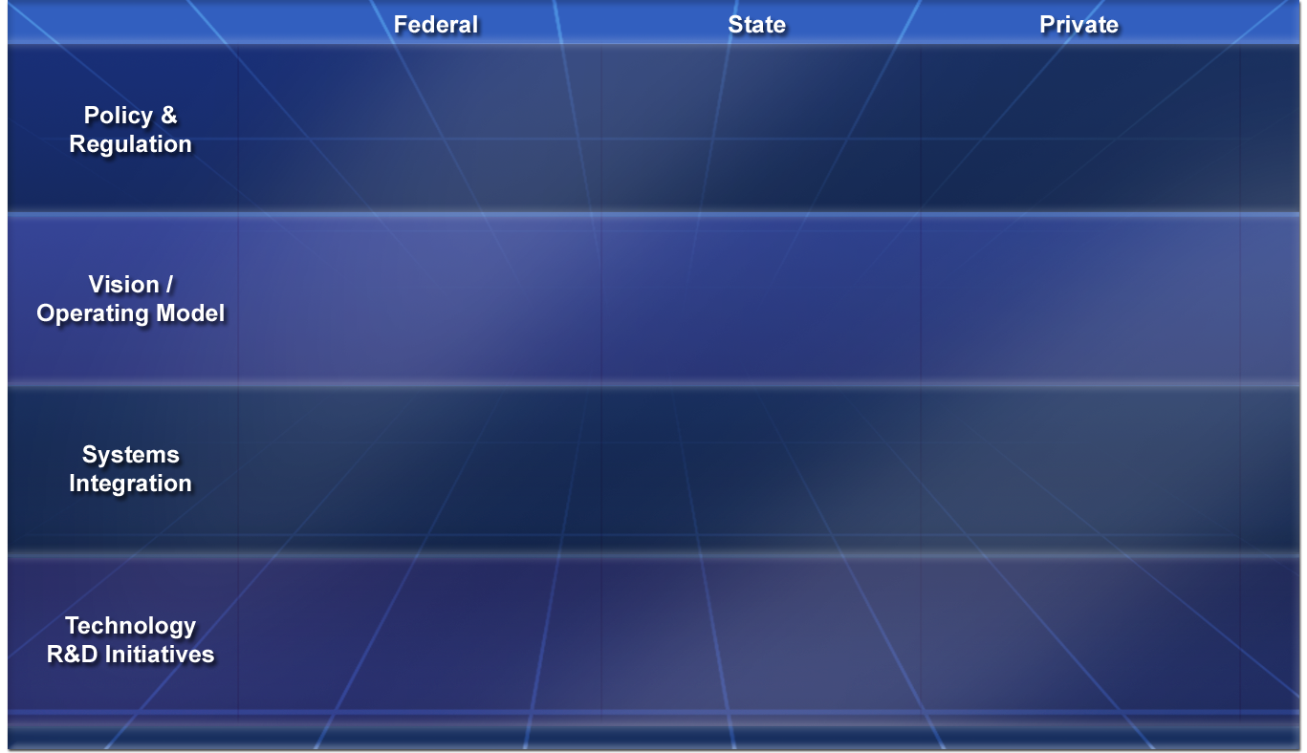
Smart Grid Activities
EPACT05 Hearings
European Technology Program - SG
Individual Utilities
FERC
EISA 2007
GWAC
EEI
T24
CEC PIER
MEMS
NERC
(FM)
GridWise
Alliance
DOE-OE
Grid 2030
Standards Groups
UCA Users Group WG’s
LBNL DRAS AUTO DR
Galvin
Initiative
NETL Modern Grid Initiative
IEEE IGCC
NIST Roadmap
EPRI
Intelligrid
GridWise
Program
NW GridWise Testbed
CPUC
AMI
ZigBee
GridWorks
CERTS
NYSERDA
GridApps
DOE-OE
PSERC
DV 2010
Notes:
29

Slide 31
Developers of the Modern Grid
Grid Modernization: a Non-Trivial Task
Each organization has a constituency, but:
Visions are Aligned
Goals are Remarkably Consistent
Tactics are Complimentary
Modern Architecture Concepts are Being DevelopedAdopted, Developed, and Applied
Collaboration is Occurring

Slide 32
Visioning Hides the Details
Who can argue with cool vision?
Standard pundit diagram:
House with a PV panel
Electric car
Demand responsive loads

Slide 33
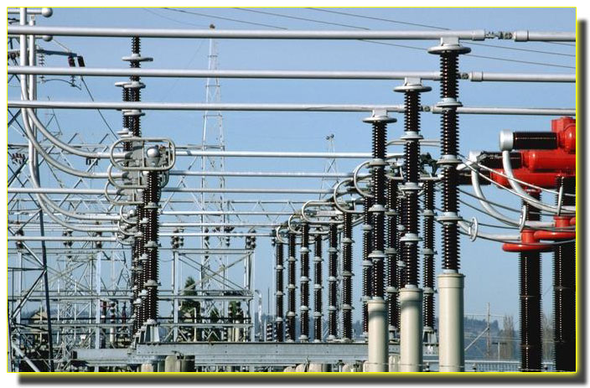
That’s great but …
Now the Hard Part: Systems of Systems Engineering
Scalability – lots of stuff
Reliability – its gotta work
Security – don’t screw up
Privacy – think about it
Configuration Management – lots of stuff
Network Management – more stuff
More value through Integration – Opportunity!
“Any competent engineer can glue two systems together and make it work. But it takes sound architecture and good systems engineering practice to make the resulting system scaleable, manageable, secure – and oh, yeah… address the business case.”
- Erich W. Gunther,
EnerNex co-founder

Slide 34
DANGER: Smart Grid Integration without Standards or Architecture
It is not sufficient just to integrate systems haphazardly
There must be an overarching plan, or blueprint
Otherwise, vital systems integration may be prevented because of:
High costs
Missing technology

Slide 35
CHALLENGES OF INTEGRATION: Building Isolated Systems
Energy
Markets
Utilities and vendors tend to develop intelligent systems in isolation
For example, AMR and participation in energy markets
Neither project is typically developed with the other in mind.
AMR
Notes:
Most utilities tend to develop intelligent systems in isolation, with unique interfaces determined by the needs of the particular project that was funded at the time. For instance, a utility may decide to participate in energy markets; it may also implement automatic meter reading. However, neither project may be developed with the other in mind.

Slide 36
CHALLENGES OF INTEGRATION: One-Off Integration
Integration is typically done after the fact
Cost is significant
Energy
Markets
AMR
Notes:
If the utility decides to try to integrate these functions, this integration, too, is done in a “one-off” or project-oriented manner. This of course costs significant money to do.

Slide 37
CHALLENGES OF INTEGRATION: Doing it the Next Time
Now want to link in new systems
Must first make the old system expandable
Then must do another “one-off” integration
Energy
Markets
Outage
Management
AMR
SCADA
Notes:
The next time a similar integration project is needed, the utility must first spend money to make the original integration expandable. Then it must perform a MORE complicated integration phase to link the new system into the old one.

Slide 38
CHALLENGES OF INTEGRATION: And again…
Energy
Markets
Outage
Management
Real-Time
Contingency
AMR
SCADA
Protection
Notes:
The pattern repeats, each time costing more money and becoming more awkward technologically.

Slide 39
CHALLENGES OF INTEGRATION: And then you remember…
Energy
Markets
Outage
Management
Real-Time
Contingency
Security
AMR
SCADA
Protection
Notes:
Until finally, some flaw is found that will prevent the system from expanding because it should have been designed into the system from the beginning. This may cause nearly catastrophic costs, or simply prevent any further expansion.

Slide 40
Doing it Right: Top-Down Architecture
Energy
Markets
Define standardized interfaces first
Incorporate security, network management and other strategies right from the beginning
Initial costs are a bit more than one-off integration, but not much more
New applications can build directly to the new architecture
Security
Network Management
Data Management
AMR
Notes:
The right way to develop an intelligent system is from the top down. By defining standard interfaces first, and planning for the future, high costs can be prevented later. New applications can build directly on to the architecture as it is defined.

Slide 41
Doing it Right: The Next Phase
Can re-use the development from the first phase
Expansion was expected
Adaptation to legacy systems was planned in advance
Overall costs much lower
Energy
Markets
Outage
Management
Outage
Management
Security
Network Management
Data Management
AMR
SCADA
SCADA
Notes:
However, the point of integration is to make use of existing intelligent systems. These can be done at much lower costs, if there is an initial architecture in place that allows for expansion and is ready for legacy systems.

Slide 42
Doing it Right: And so on…
Energy
Markets
Outage
Management
Outage
Management
Real-Time
Contingency
Benefits INCREASE with time
Opposite of the old way
Security
Network Management
Data Management
AMR
SCADA
SCADA
Protection
Protection
41
Notes:
Unlike the “one-off” method, the costs of a properly architected systems integration do not increase significantly with time, and the benefits will increase.

Slide 43
The Value of Top Down Integration
Permits existing infrastructure to be re-used
Eliminates redundant effort and last minute retrofits
Prevents forklift upgrades
Vital system-wide capabilities, like security, comes standard
Prepares the system for unforeseen change:
New technology
New applications
New organizational change
Incremental
DEVELOPMENT
Reduced
RISK
Reduced
COST!

Slide 44
Barriers to Planned System Integration
Organizational
Corporate culture
Existing policies
Departmental “Silos”
Lack of human resources
Knowledge
Missing applications
Missing algorithms
Lack of training
Systems
Lack of standards
Too many “standards” to choose from
Missing products and services
Not applying formal methodology
Business
Lack of policy to use standards
Not writing it into RFP’s
Notes:
The barriers to this type of integration and the creation of an Intelligent Grid fall into the three categories listed here. Now we need to brainstorm about how to get around them.

Slide 45
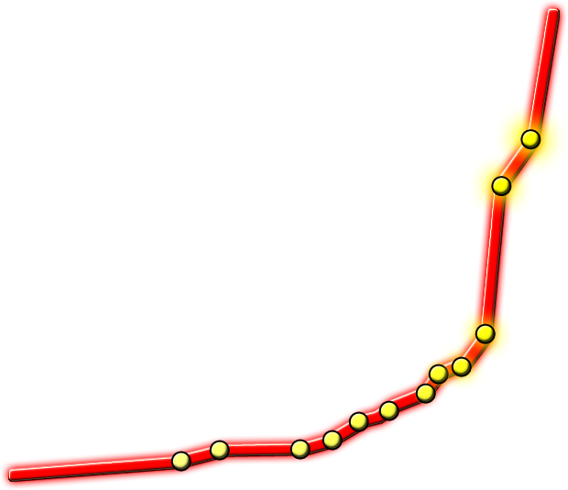
Smart Grid Data Explosion
New devices in the home
enabled by the smart meter
800 TB
600 TB
OMS Upgrade
PCTs Come On-line
Annual Rate of Data Intake →
RTU Upgrade
400 TB
AMI Deployment
Mobile Data Goes Live
You are here.
Distribution Management Rollout
200 TB
GIS System Deployment
Time →
Substation Automation System
Advanced Distribution Automation
Workforce Management Project

Slide 46
Why Use Standards?
Avoid re-inventing the wheel
Learn from industry best practices
Specify requirements more easily
Reduce integration costs
Prevent single vendor “lock-in”
Vendors share a much larger market

Slide 47

Standards Roadmap
Capabilities
Priorities
Reference Model
Standards
Release Plan
Responsibilities
Governance
Testing and Certification

Slide 48
Roadmap Focus Areas
Priority applications:
Demand Response
Wide-Area Situational Awareness
Electric Storage
Electric Transportation
Additional priority applications:
Advanced Metering Infrastructure
Distribution Grid, including Distributed Energy Resource Integration
Cross-cutting priorities
Cyber Security
Data networking

Slide 49
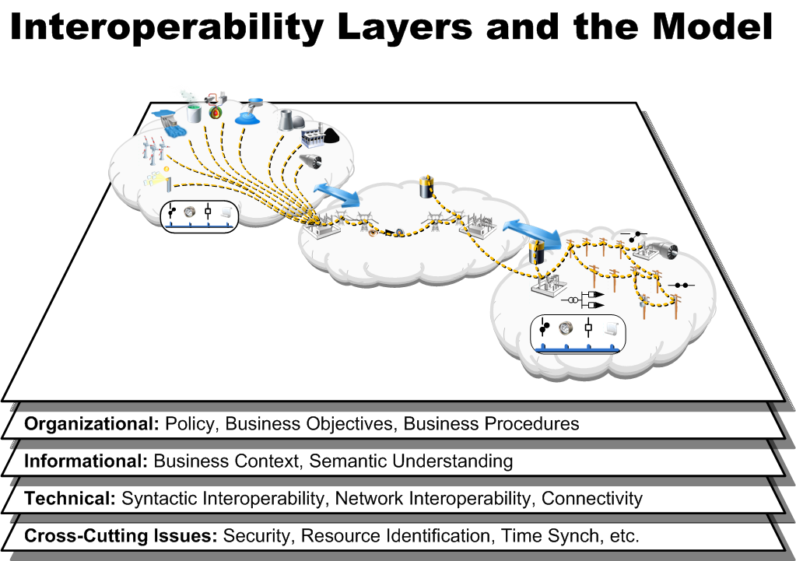
Interoperability Layers and the Model

Slide 50
What Does the Smart Grid Need?
For the applications of interest, can we agree on:
What information is to be exchanged?
What is the data to be named?
Who is permitted to talk?
In what format are messages transmitted?
What frequencies and signals are used?
What the connector looks like?
The answers are different for:
Different physical areas of the grid
Different functions to be performed

Slide 51

What is a Smart Grid, Really? An example: Active Distribution Network
Multi Agent System (MAS) Platform
Agent/Moderator
~
~
Voltage regulation
Distributed State Estimation
Local Control Scheduling
Power management
Other actuators
HV/MV
~
~
Other moderators
~
~
Local control area
Cell
Agent

Slide 52
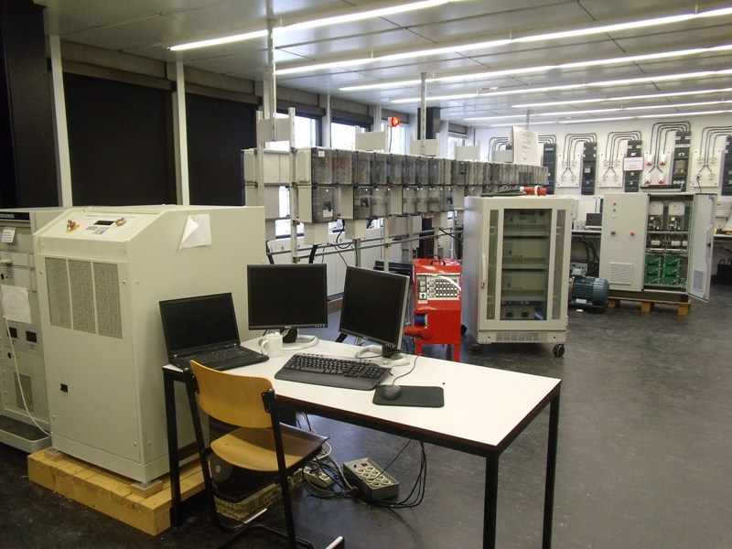
TU/e – Lab Set-up
Inverter system
Main source
WT
emulator
Fix
load
Programmable
load
Multi Agent System

Slide 53

TU/e Lab Set-up
Power Router
AC sources
Fixed
Load
~
~
Fixed
Load
WT
Emulator
=
=
Inverter 1
Inverter 3
Area 1
Area 2
Area 3
Inverter 2
~
=
Programmable load

Slide 54
Part IV – Laboratory set-up
Case Study – MAS interaction: Active power flow through inverters

Slide 55
Other Examples:
Virtual Inertia

Slide 56
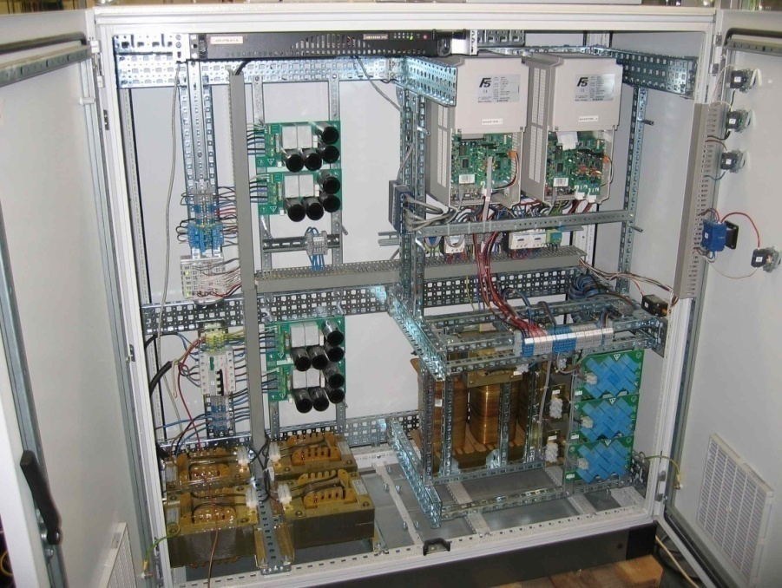
Other Examples:
Virtual Inertia

Slide 57
Other Examples:
Virtual Inertia

Slide 58
Other Examples:
Power Quality Intelligent Inverters

Slide 59
The Main Technical Issues affected by MG-DG-DER-RES (Smart Grids)
The majory of implications are related to:
Active and reactive energy flows paradigm;
DG interconnections and Islanding;
This is a new issue and the problems that occur have old solutions, generally timing the tripping.
Plug-and-play and peer-to-peer.

Slide 60
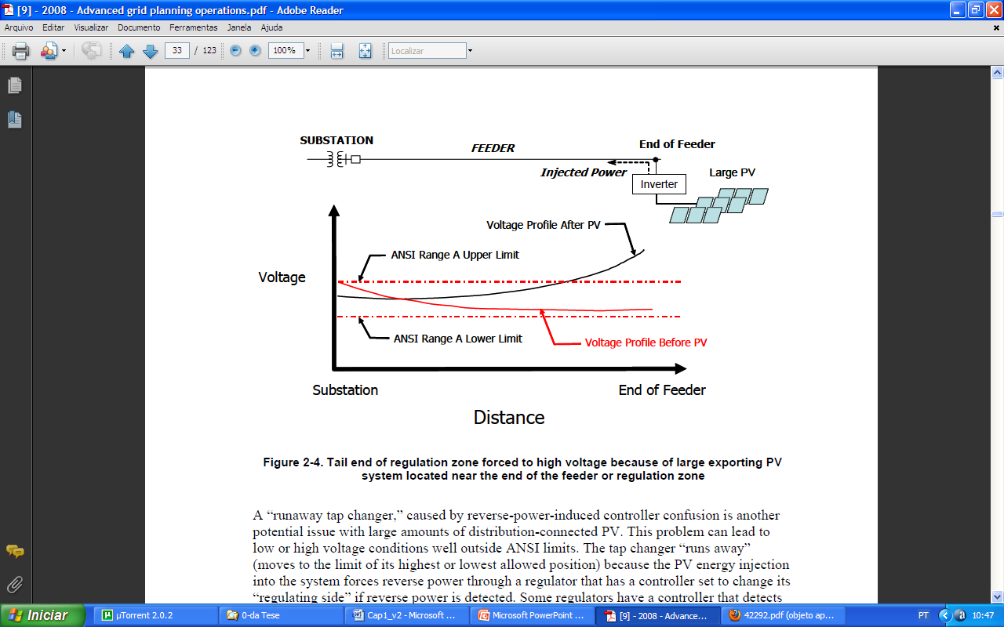
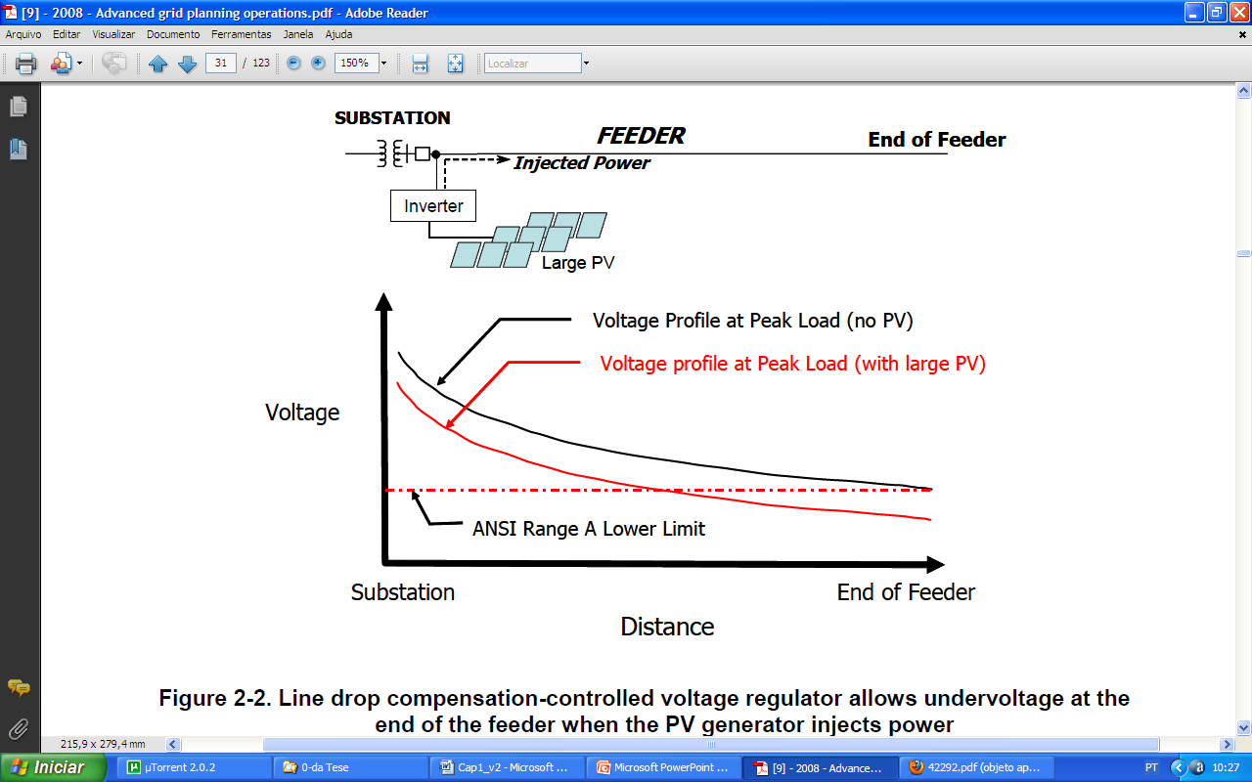
The Main Technical Issues affected by MG-DG-DER-RES (Smart Grids)
Voltage Regulation
Notes:
The voltage-regulation practices used on power distribution systems generally assume that there are no power sources on the system other than the substation. This means that all flow is outward from the substation source toward the ends of the feeders. To regulate this type of condition, utilities typically use LTC transformers at the substation, stepped voltage regulators on longer feeders, and switched capacitors. All these devices have control settings and functions that are generally coordinated for the system voltage drop profile that occurs with the substation set up as the sole source of power. The ideal condition is to hold all customers within the band of ±5% voltage (what is known as “ANSI Service Voltage Range A” or simply “ANSI Range A”). As soon as DG is added to the system, the basic assumption that there is no other source on the feeder collapses and voltage problems can ensue if the capacity of the added source is significant with respect to the distribution feeder capacity.
Undesirable interactions with line drop compensators:
The first problem results from the fact that line drop compensation (a method of measuring current at a regulator terminal and calculating downstream voltage drop to a remote point on the feeder to compensate for the drop to that point) can be confused by the presence of distribution-connected forms. If a large DG unit is placed on the distribution line just after the regulator unit, and if that unit masks the regulator from seeing the current of the load, the regulator will not know how large the actual line current is and will not boost the voltage adequately to compensate for the voltage drop. The generation that causes this effect could be of any type, including PV, wind, fuel cell, and so on.

Slide 61
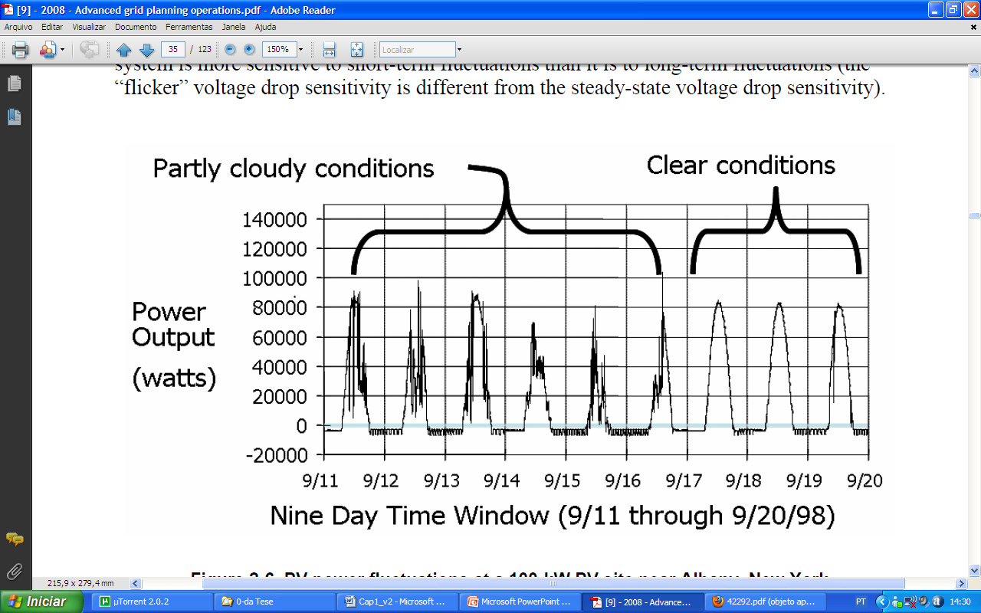
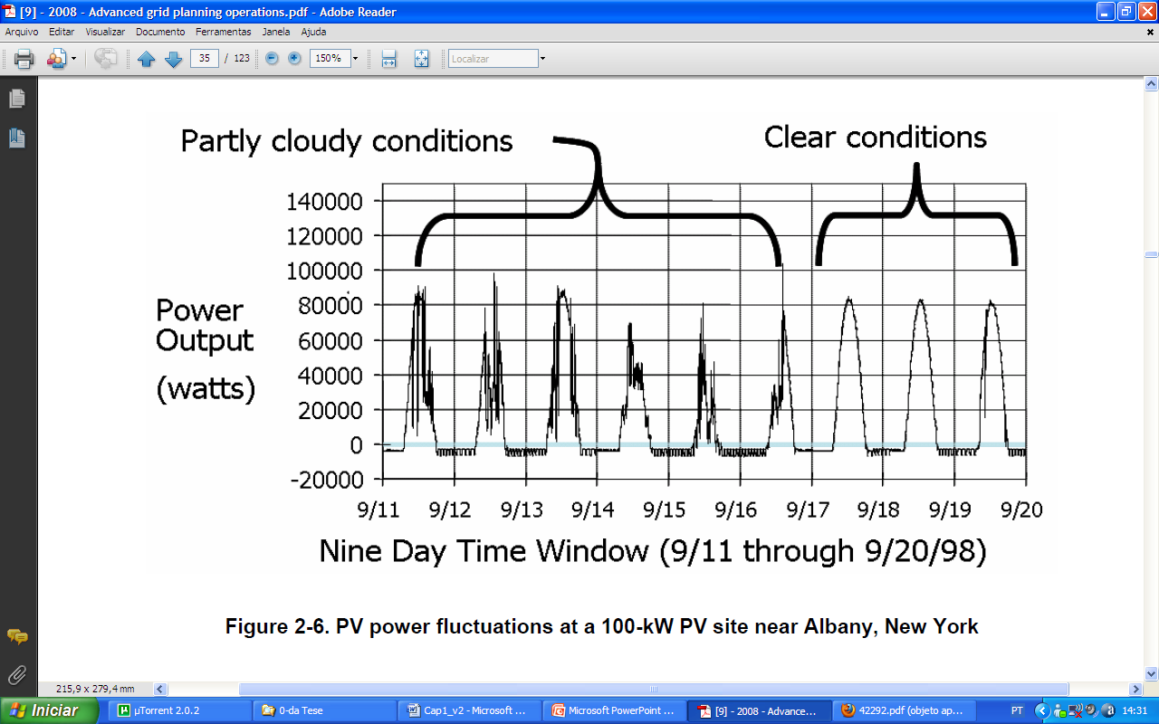
The Main Technical Issues affected by MG-DG-DER-RES (Smart Grids)
Voltage Regulation
Distribution-connected PV and wind energy sources in particular can fluctuate considerably and, with high penetration, can lead to noticeable problems, such as the ramp up or down caused by moving clouds.

Slide 62
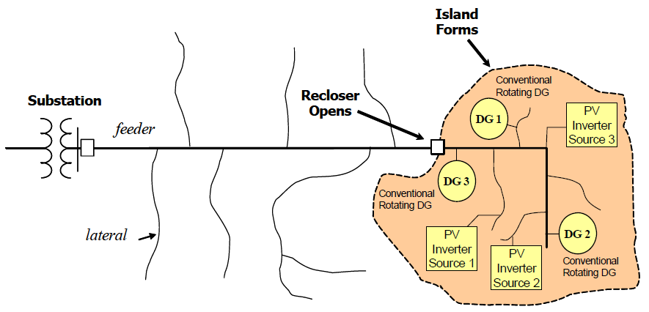
The Main Technical Issues affected by MG-DG-DER-RES (Smart Grids)
Island
Intentional;
Unintentional.
Notes:
Unintentional islands are a threat to proper utility system operation for a number of reasons:
• If an unintentional island forms and lasts long enough, the upstream utility system may attempt to reclose into it with an out-of-phase condition, which can damage switchgear, power generation equipment, and customer loads.
• An unintentional island may increase public exposure to unsafe, energized downed conductors.
• Line crews working on power restoration following storms or other events may encounter unintentional energized islands, making their job more hazardous and slowing down the power restoration process.
• Unintentional islands do not usually have their generators set up with the proper controls to maintain adequate voltage and frequency conditions to the customer loads. Because PV inverters are currently set for voltage following, they do not help control the voltage during islanding conditions. In future scenarios where islanding is part of the system design, inverter controls will be used in a voltage-control mode to prevent unacceptable voltage conditions in the local island.
• Transient overvoltages caused by ferroresonance and ground fault conditions are more likely when an unintentional island forms—for example, the unit might be isolated with a large capacitor bank that could trigger a resonance with energy sources on the island.

Slide 63
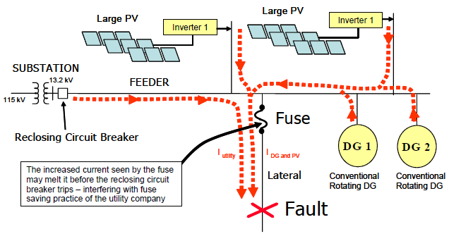
The Main Technical Issues affected by MG-DG-DER-RES (Smart Grids)
Protection
Fuse Coordination (PV example)
Notes:
Fuse Coordination:
Another example of the impact of distribution-connected DG on the overcurrent protection system is how fault contributions affect fuse and circuit breaker coordination.
The whole concept of fuse saving can be adversely affected if the fault current at the fuse should rise to a level where it melts (blows) before the circuit breaker clears the fault (the higher the fault level, the faster the fuse melts). If distribution-connected DG are added to the system and fault levels go up sufficiently, fuse-saving coordination may be in jeopardy. The figure is an example showing how these energy sources can change the fault level at the fuse when placed on the system. Because the fastest total fault-clearing time on most distribution feeder circuit breakers is about five cycles, as soon as the fault levels are increased enough that the fuse damage time is reduced to nearly this number of cycles, the coordination will be in jeopardy.

Slide 64
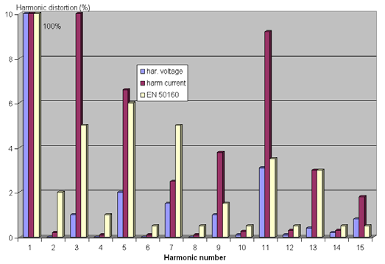
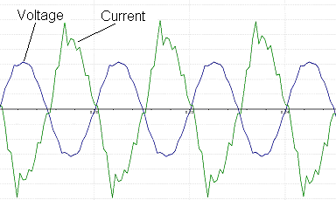
The Main Technical Issues affected by MG-DG-DER-RES (Smart Grids)
Harmonics
To the high amount installed DG-inverters, the interaction between inverters harmonic currents and background harmonic voltage multiplied by the resonant behavior of the grid and loads harmonic distortion became significant
Notes:
There are harmonics concerns with both rotating machines and inverters, although concern with inverters is less with modern technologies. The situation will change in the micro grid situation because of the changing parameters of grid impedances, background voltages and available short circuit power. To couple the storage system to the micro grid an inverter has to be used. This inverter must be capable to reduce the harmonic distortion of the voltage, even in the situation that the short circuit power will be decreased.
The main problems today are the high harmonic distortion and the voltage level. In the cottages, connected at the end of the cable, the voltage level was reaching the limit of 253 V. The voltage level problem is solved by decreasing the voltage level at the low voltage side of the transformer, using the tap changer of the transformer. Because of the fact that the load in the cottages is relatively small, this was the most efficient solution.
An interesting point of research is how this harmonic distortion can be solved in a microgrid situation. On one hand side, the existing resonance problem caused by the interaction with the grid will disappear in case of operating decoupled from the grid. On the other hand the decreased short circuit power on the LV-side causes further problems. Without countermeasures, in weak networks harmonic currents will, have a greater effect on generating harmonic voltages.
Analyzing the harmonic voltage, the value of the 11th harmonic voltage at the low voltage side of the transformer was 3% of the nominal voltage, near to the limit of 3.5%. The 15th harmonic exceeds the limit of the Standard EN50160.

Slide 65
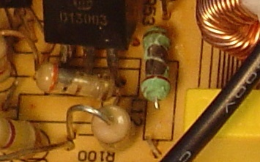
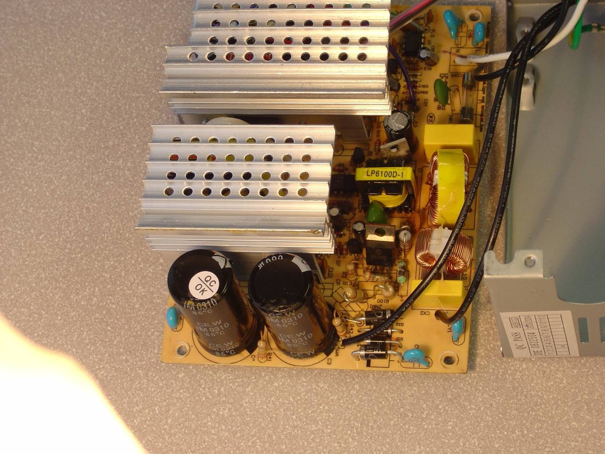
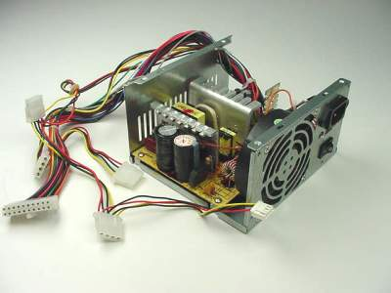
The Main Technical Issues affected by MG-DG-DER-RES (Smart Grids)
Waveform Impacts

Slide 66
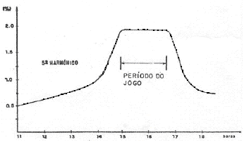
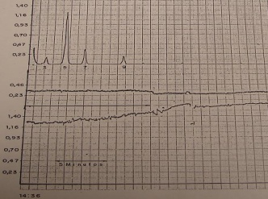
Measurement in Fortaleza 230 kV During the World Cups of 1986 and 2006
The Main Technical Issues affected by MG-DG-DER-RES (Smart Grids)
)
5th Harmonic (%)
YEAR 2006
The system impedance (at 5th harmonic frequencies) at the Fortaleza substation is lower now than it was 20 year ago.
Period of the game
5th Harmonic (%)
YEAR 1986
Hour
Probably, the power supply of the modern TV receivers have a much smaller harmonic injection content.
Period of the game
11 12 13 14 15 16 17 18 Hour
11 12 13 14 15 16 17 18 Hora

Slide 67
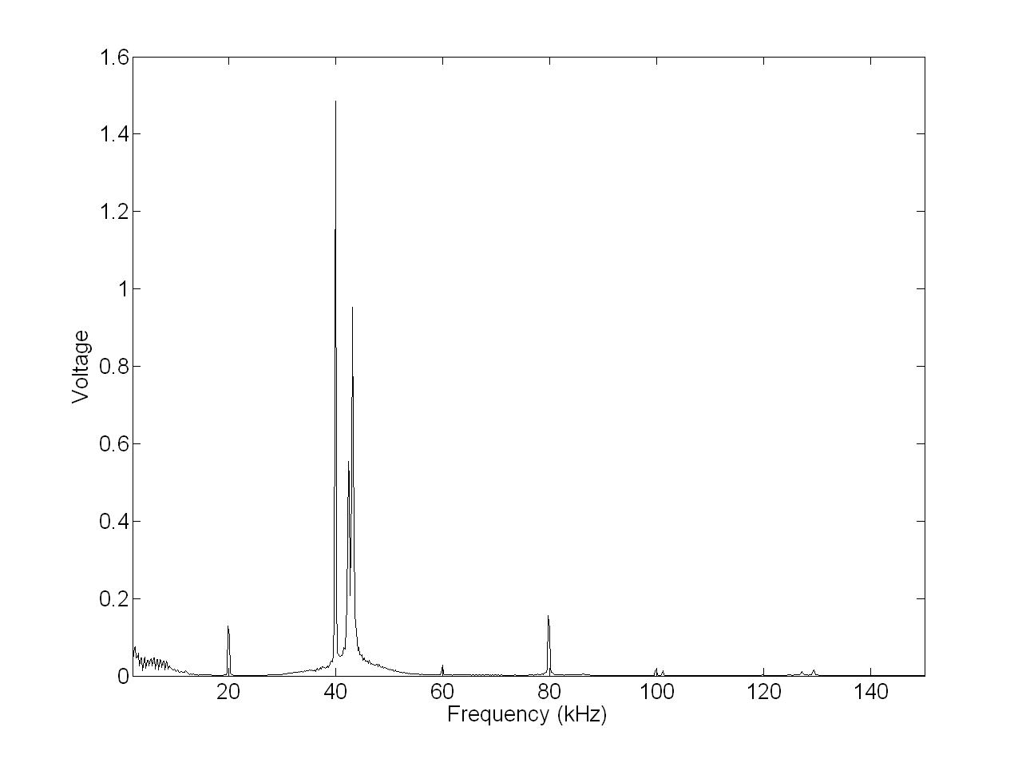
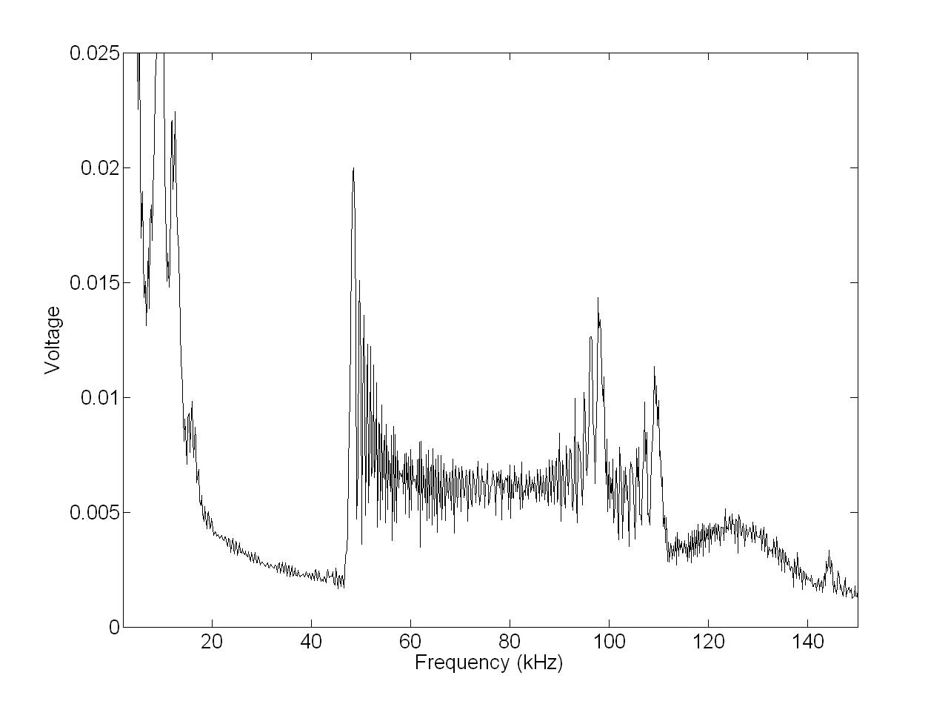
The Main Technical Issues affected by MG-DG-DER-RES (Smart Grids)
High Frequency Harmonics
Measured spectrum from HF fluorescent lamp with APFC.
Spectrum from induction cooker (40 kHz) and PLC (43 kHz)

Slide 68
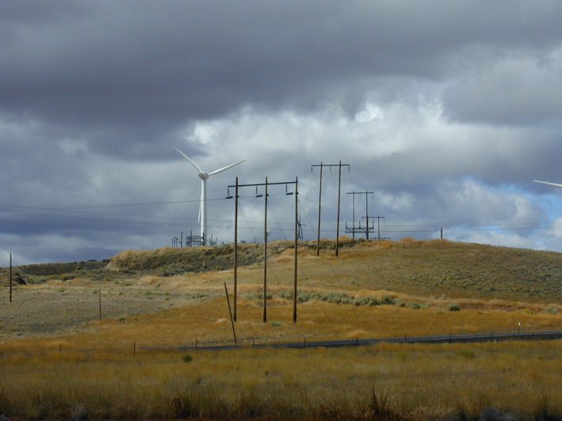
The Main Technical Issues affected by MG-DG-DER-RES (Smart Grids)

Slide 69
The Main Technical Issues affected by MG-DG-DER-RES (Smart Grids)
Aggregation of New
Non-Linear Sources

Slide 70
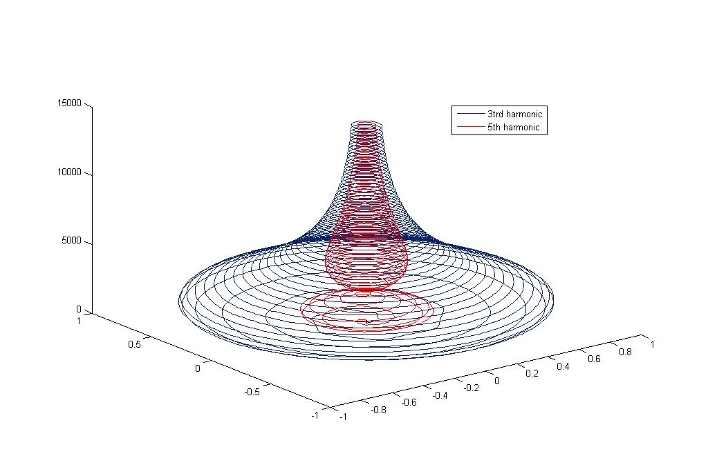
The Main Technical Issues affected by MG-DG-DER-RES (Smart Grids)
Time-Varying Harmonics: New Paradigm

Slide 71
The Main Technical Issues affected by MG-DG-DER-RES (Smart Grids)
Others:
Stability (voltage and frequency);
Transients;
Unbalance;
Resonance;
Measurement;
Faults;
Short circuits levels;
Sustained Interruption.

Slide 72
What will be the Implications on Signal Measurement
In the smart grid, reliable and online information becomes the key factor for reliable delivery of power from the generation units to the end-users.

Slide 73
What will be the Implications on Signal Measurement
Why smart metering?
User Profile, Energy Efficiency Measurement, Benchmarking, Management, Energy cost allocation and analysis, Building Control, Demand Control, Automation, Preventive Maintenance, Power Quality Measurement, Fault Analysis, Check Meter, Carbon emission reduction.
A smart grid requires advanced monitoring and analysis that can anticipate contingencies and prevent local disturbances by intelligent monitoring.

Slide 74
What will be the Implications on Signal Measurement
Recent needs:
Accuracy (Ex: to control power flow) ;
Syncronized measurements (Ex: syncrophasors);
Measurement in many nodes of power networks;
Measurement information meet the standards that recommend a proper well-established uncertainty;
New issues:
Reliability of electronic meters;
Power quality/EMC;
Power line communication;
On-site testing and quality management;
Software security;
Small scale production of electricity.
Notes:
This recent need for accurate, synchronized measurements at both the supplier and customer sides results from different causes: with the continuous growth of distributed generation, utilities can sell and buy electricity from customers, requiring correct information of the amount of energy that is delivered or injected into the network by
both sides. Moreover, the instant control of the power flowing into the network branches requires sensors to provide the most accurate power measurements possible. Indeed, the uncertainty affecting the measurement results will propagate through the control algorithms and significantly influence the position of the working point.
It is certain that all critical features of smart grids will be possible due to the measurement of electrical quantities in
many nodes of power networks combined in distributed measurement systems. Devices with decision-making
algorithms will control information coming from the electric grid apparatus and sensors that measure the electrical
quantities of power networks. The most critical aspect in smart grid operation is that the measurement information be in the correct terms and meet the standards that recommend a proper well-established uncertainty. Then, all decisions that will be made in the automatic control of electric grids will result in correct or consistent decisions. Highly accurate voltage and current sensors will be needed to measure the new electrical quantities that will be present.
The method consists of measuring voltage and/or current phasors with high accuracy in different nodes of the power network (synchrophasors) by using proper measuring systems (PMU) which are synchronized to a common
time reference, usually the GPS. Typical parameters of synchrophasors are frequency, amplitude and phase. For the
synchrophasor measurements, voltage (or current) sensors are required to have phase errors that are less than 1 mrad and a ratio error on the order of 0.1%. These accuracy values are a common requirement for the US market. Different values may be required in other countries. Also, the US utility market usually requires that synchrophasors be measured by using outdoor instrumentation (outdoor PMU). This implies two main constraints:
The voltage/current sensors (and the unit of measurement) must guarantee accuracy under particularly harsh
environment conditions (temperature, dust, pollution, UV rays, salinity, etc.);
Voltage/current sensors must be installed in hot line conditions, i.e. with an operating power line, through
particular probes.

Slide 75
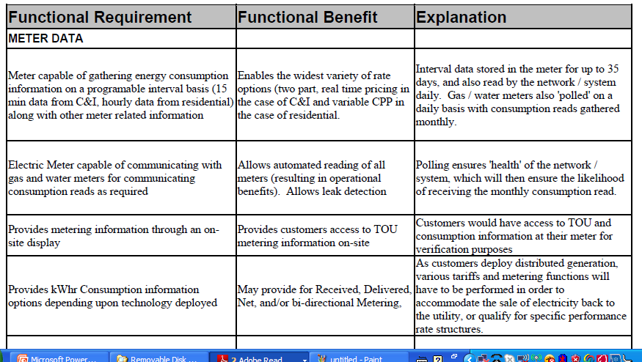
Smart Meter Requirements

Slide 76
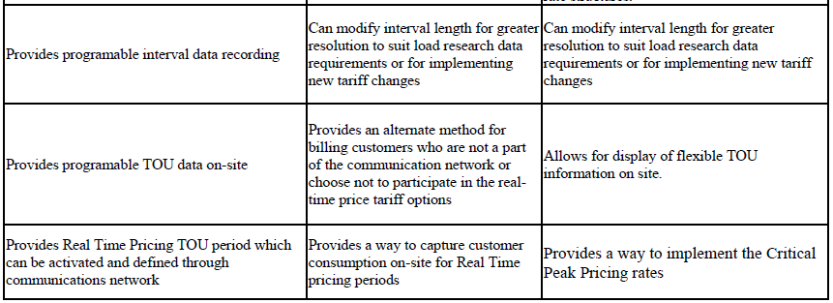
Smart Meter Requirements

Slide 77
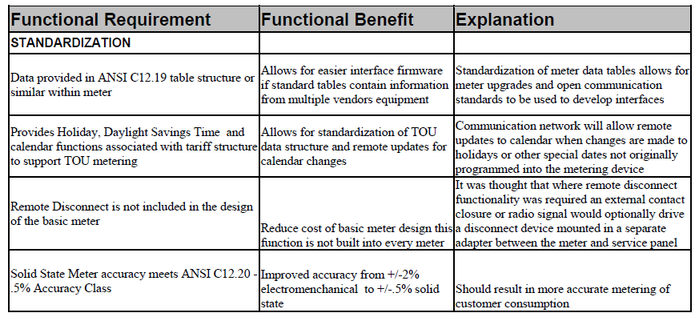
Smart Meter Requirements

Slide 78
Opportunities for Research and Development
From an overall system performance perspective, the efficiency of generation and the transmission and distribution systems has improved slightly, while capacity factors, system reliability, and power quality has remained mainly flat.

Slide 79
Opportunities for Research and Development
DG, T&D automation, smart meters
Real-Time data sharing, distributed resources interconnection standards, advanced measurement systems
Load participation, micro grids, plug-in EV, etc.
Cyber security, open-architeture / standards

Slide 80
Opportunities for Research and Development
Development
Substantially increase the use of existing production assets;
Readily accommodate new generation, transmission, distribution, and consumer technlogies;
Actively identify and extract energy efficiency throughout the system;
Address growing complexity of efficient system operations through highly distributed automation;
Deliver appropriate levels of power quality, and reliability to different end-use needs;
Improving the security posture of the system.

Slide 81
Opportunities for Research and Development
Proposed Areas of Research on General
Understand the interdependencies of electric, communications, and other infrastructures, as well as their reaction and stability to system disturbances;
Study the behavior of end-users reaction to and acceptance of smart grid functions;
Analyze the impact on generation, transmission, and distribution capacity from DER in demand response markets, including prices that reflect system operating constraints;

Slide 82
Opportunities for Research and Development
Proposed Areas of Research on General
Estimate the ability of smart grid resources to enhance energy efficiency including awareness, diagnostics, and validation of energy efficiency programs;
Estimate the societal benefits of smart grid and considerations for cost/benefit allocation by policymakers;
Standardize formats for smart grid device and system description and exchange;
Integrate smart grid engineering models with service provider enterprise systems, e.g., work order, outage management, and AM/FM/GIS systems;

Slide 83
Opportunities for Research and Development
Proposed Areas of Research on General
Research mixed direct and alternating current electric distribution technologies;
Advance power electronics technology for electricity transformation to manage storage, charging stations, voltage control, and reactive compensation;
Verify performance of smart grid technologies, including control methods and interoperability;
Provide test processes and facilities to support product development;
Develop requirements and tests to advance interoperability and ease integration, maintenance, and upgrade;

Slide 84
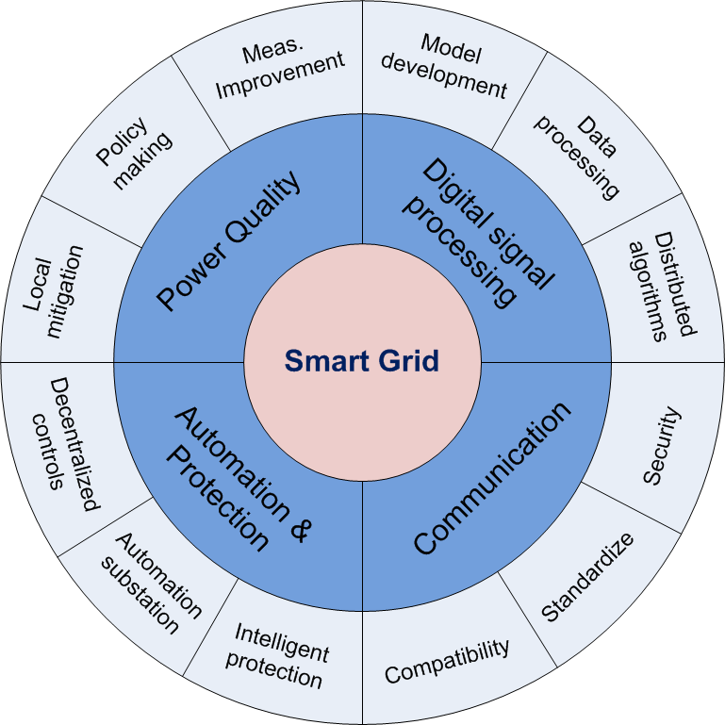
Opportunities for Research and Development

Slide 85
Opportunities for Research and Development
Challenges
Research and Development
DG Integration (Catalyzer)
Compatibility with Transmission Requirements and Load Sensitivity
Levels of Penetration per Technology
Integration of Communications and Computer Control
Systems Issues
State Estimation for Contingency Analysis
Modeling and Simulation: Graph Visualization e Software Integration
Probabilistic Aspects and Novel Techniques
Technology Development

Slide 86
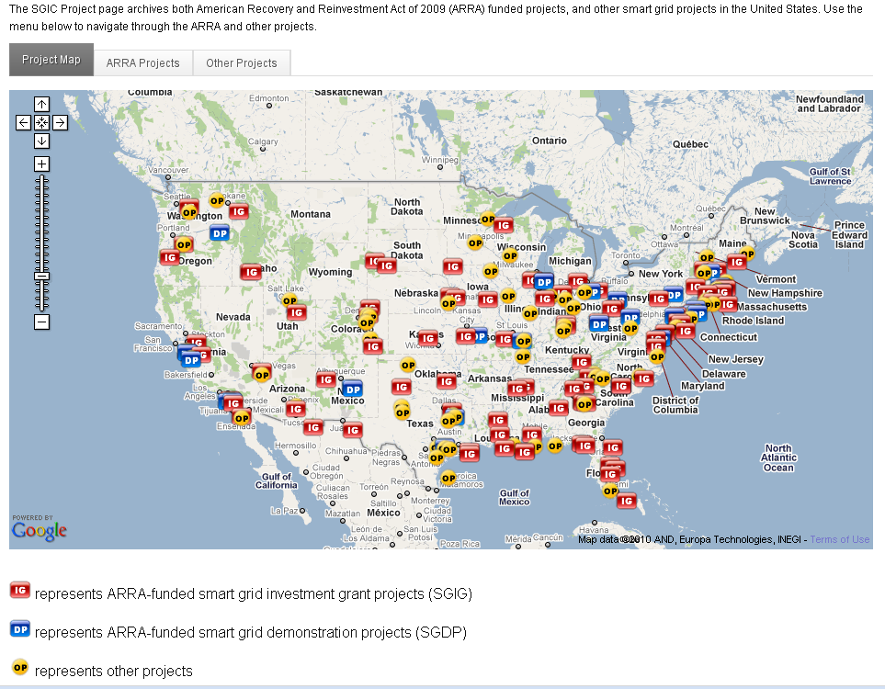
Smart Grid Projects in the USA

Slide 87
What Smart Grids Do NOT Mean?
The smart grid relates to the electricity network only – it concerns both distribution and transmission levels.
Smart grids are not new “super grids”. They will not look significantly different to today’s “conventional” electricity grids transporting and distributing power over “copper and iron”. However, smart grids will lead to improved cost-efficiency and effectiveness.
The smart grid is no revolution but rather an evolution or a process within which electricity grids are being continuously improved to meet the needs of current and future customers.
There will not (and cannot) be any “roll-out” of smart grids, since such a “roll-out” is continuously occurring.
Although the concepts are sometimes confused, the smart grid is not smart metering – the smart grid is a much broader set of technologies and solutions (see diagram below).

Slide 88
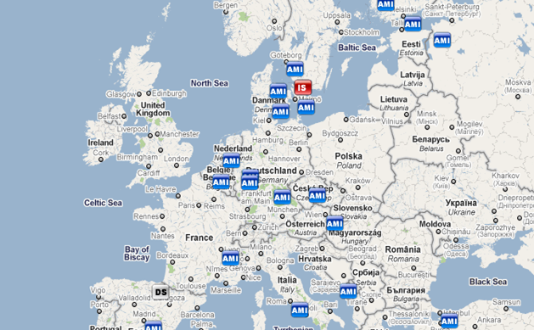
Smart Grid Projects in Europe

Slide 89
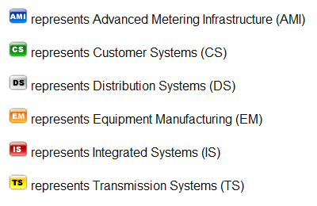

Slide 90
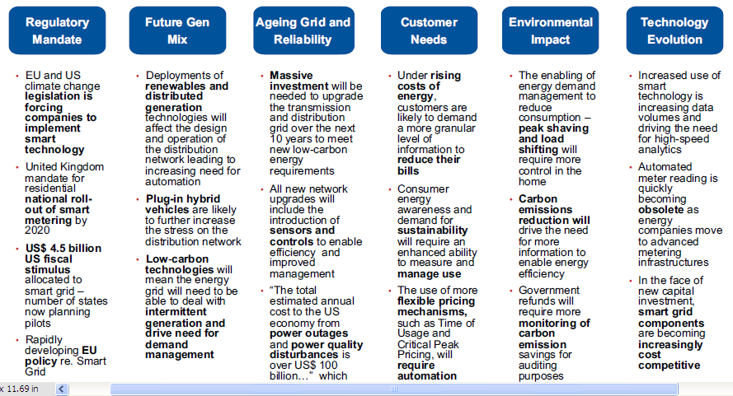
Factors Driving Smart Grid Development

Slide 91
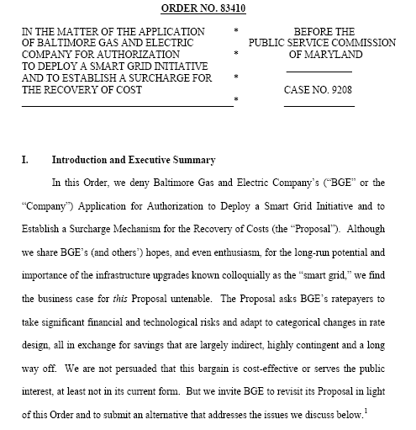
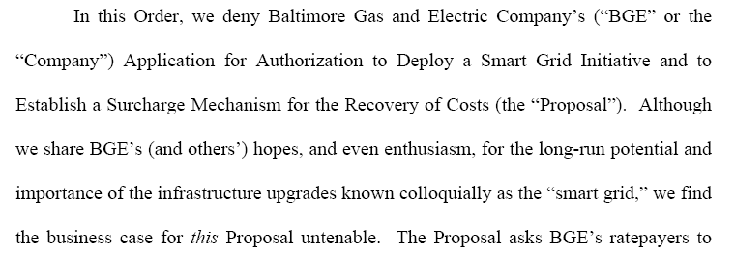
Politics and Economics: PSC of Maryland
Decision on Smart Grid Proposal

Slide 92
Politics and Economics: PSC of Maryland
Decision on Smart Grid Proposal

Slide 93
Politics and Economics: PSC of Maryland
Decision on Smart Grid Proposal
Supply-side benefits relies upon numerous key assumptions, including, among others:
(1) customers will continue to receive a PTR rebate equal to the initial estimate of $1.25/kWh;
(2) 70% of non-PeakRewards residential customers and 50% of non-PeakRewards small commercial customers will participate in shifting their energy use during declared critical peak periods;
(3) those non-PeakRewards residential customers who do participate will reduce their peak load by an average of 0.49 kW and those non-PeakRewards small commercial customers who do participate will reduce their peak load by an average of 0.60 kW; E value of $176 per MW-day.102

Slide 94
Politics and Economics: PSC of Maryland
Decision on Smart Grid Proposal
(4) 90% of PeakRewards residential customers and 50% of PeakRewards small commercial customers will participate in shifting their energy use during declared critical peak periods;
(5) those PeakRewards residential customers who do participate will reduce their peak load by an average of 0.10 kW and those PeakRewards small commercial customers who do participate will reduce their peak load by an average of 0.12 kW, both of these in addition to their PeakRewards peak load reduction;
(6) R-SEP and customer access to certain data through the web portal will reduce overall consumption by 1%; and 24
(7) capacity prices subsequent to the 2012-13 delivery year will, on average, equal the 2012-13 SWMAAC NetCONE value of $176 per MW-day.102

Slide 95
Conclusion
Many of the standards we need are already there
There are different needs in different environments
Define new applications and procedures
Agree on common information models
Adopt, evolve existing technologies and protocols
Develop new technologies and protocols
Apply systems engineering discipline
Each of these tasks comes with a cost
Standards provide the most benefit when implemented frequently and pervasively
Pay attention to the business case
Specify the use of standards in RFP’s
Synchronize with the NIST roadmap

Slide 96
Conclusios
Electric Power and Energy Systems will continue to grow in complexity and importance as the electric sector operates within a truly free economy.
Utilities, customers, manufacturers, universities / research institutions will have to cooperate to establish a stable model for the power sector
Recent and Advanced Technologies and Techniques will create new challenges and opportunities
Universities and Research Institutions will have to adapt to face the new environment
An integrated Approach Is Essential to Guarantee Sustainability
Vision, Philosophy/Strategy and Integrated Initiative

Slide 97
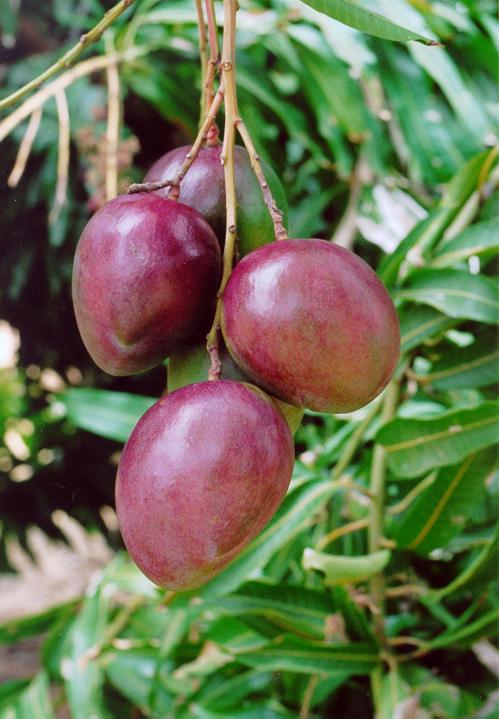
Beyond Engineering Projects
A couple of years ago, when I was at grocery store in Grand Rapids, Michigan, examining some mango fruits, I did not know I was in for a surprise: the label on the mangos read “Sao Francisco Valley, Brazil.” My heart pounded faster with excitement … this was the location of an irrigation project I had worked on its system studies for the substation expansion to include the irrigation load.
Finally, after over 25 years the connection of a power engineering project and a tropical fruit became very clear and I saw how electrical engineering plays an integral part on the wellbeing and sustainability of society – for smart living.

